Slide 1

A
Project
On
“ Airlines : We Seek Profit And Trust ”
Presented by
Mr. Shivam Borse Roll No. [BE-19]
Ms. Shraddha Lokhande Roll No. [BE-20]
Mr. Sarvdnya Dhamale Roll No. [BE-46]
Ms. Urmila Dholi Roll No. [BE-52]
Department of Artificial Intelligence and Data Science
Dr. D. Y. Patil Institute of Engineering, Management &
Research, Akurdi, Pune-44
Academic Year 2023-24
B.E. SEM I

Slide 2
Outlines:
Introduction to the Domain
Motivation
Problem Statement
Objective
Literature Review
Technologies Used
System Architecture
UML Diagram(Flow Diagram, Activity Diagram, Usecase Diagram and Sequence Diagram)
Results and Discussion
Applications
Advantages & Limitations
References

Slide 3
Introduction To The Domain:
Airlines face the dual challenge of optimizing profitability while maintaining passenger trust.
exploring the integration of machine learning techniques to achieve both financial success and enhanced customer confidence.
Machine learning algorithms in optimizing various aspects of airline operations.
Forecasting and route optimization to predictive maintenance and customer experience enhancement, project seeks to identify opportunities where machine learning can drive operational efficiency and revenue growth.
Central to the project is the notion of trust, a pivotal factor influencing passengers' decisions in choosing an airline.
Machine learning to enhance safety measures, personalize passenger experiences, and address customer concerns proactively, airlines can foster trust and loyalty among their clientele.
Machine learning models, ranging from regression and clustering algorithms to neural networks and natural language processing, are applied to extract insights and patterns from the collected data.

Slide 4
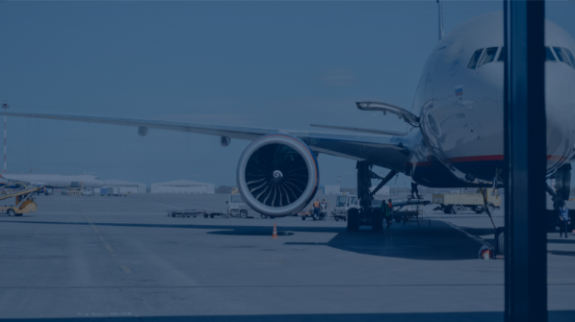
Motivation:
Operational Complexity
Data Abundance
Enhanced Decision-Making
Operational Efficiency
Trust
Competitive Edge
Industry Evolution
Ethical Considerations

Slide 5
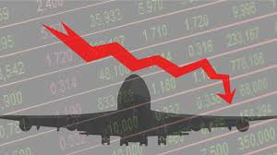

Problem Statement:
For Scheduling the flight as per customer demand by developing ML model which train on airline industry real time data .

Slide 6
Objective:
Optimize Operational Efficiency
Accurate Demand Forecasting
Safety and Risk Mitigation
Data Driven Decision-Making
Building Passenger Trust
Ethical Considerations
Market Differentiation
Long-Term Sustainability

Slide 7
Literature review:
Sr No | Paper Title | Journal Name, Year | Objective | Methodology/Technology/Algorithm used | Conclusion
1 | A Framework for Airfare Price Prediction: A Machine Learning Approach | IEEE Trans. Intell.. July 2021. | Prediction Accuracy Assessment Feature Significance Analysis Practical Implications and Industry Applications | To build the airline ticket price model at the market segment level, information about both the airline traffic and passenger volume for each market segment is required. Data collected during 2019 are used to train and evaluate the proposed model. Table I summarizes the information of these two datasets. | A machine learning framework was de- veloped to predict the quarterly average airfare price on the market segment level. Combination of the U.S. domestic airline tickets sales data and non-stop segment data from two public datasets (DB1B and T-100). Several features were extracted from the datasets and combined together with macroeconomic data, to model the air travel market Segments

Slide 8
Literature review:
3 | A Time-Optimal Trajectory Algorithm Based on Accessibility Analysis | 2021 5th International Conference on Robotics and Automation Sciences | Industrial robots Deceleration point determination Safety optimization Validate the effectiveness of the developed algorithm. Apply the algorithm to various path types (straight line, arc, spline curve) to demonstrate its practical utility. | Time-optimal trajectory Accessibility analysis Path-velocity decomposition Path parameters Cartesian space planning Interpolation point distribution Straight line path | 1.value of the number of interpolation points is discussed 2.corresponding principles are put forward to make the distribution of interpolation points more reasonable. 3.positive and negative search algorithm is proposed to determine the reachable set, which improves computational efficiency. 4.program is written for simulation experiments, and the feasibility and superiority of the time-optimal trajectory algorithm are verified based on the simple path
4 | Airline ticket price and demand prediction: A survey | Article history: Received 3 September 2018 Revised 5 January 2019Accepted 1 February 2019 Available online 5 February 2019 | 1. The main goal is increasing revenue and maximizing profit. 2.Present -comprehensive literature review of existing studies related to this topic which can be utilized by future researchers | 1. The machine learning methods consisted of REPTree classifier and-regression-model (PLS regression, Ridgeregression 2.optimal ticket purchase time optimizing model based on a special preprocessing step known as marked point processes (MPP) | Ticket prediction and demand prediction models. the strengths and weaknesses of existing work. Our analysis result showed that this research area has not been greatly explored and that there exist several aspects which contain media data and search engine query
8

Slide 9
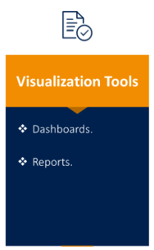
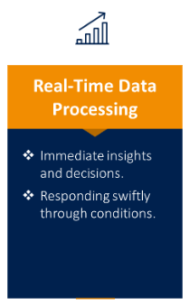
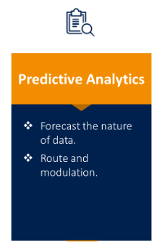
Technologies Used:
9

Slide 10
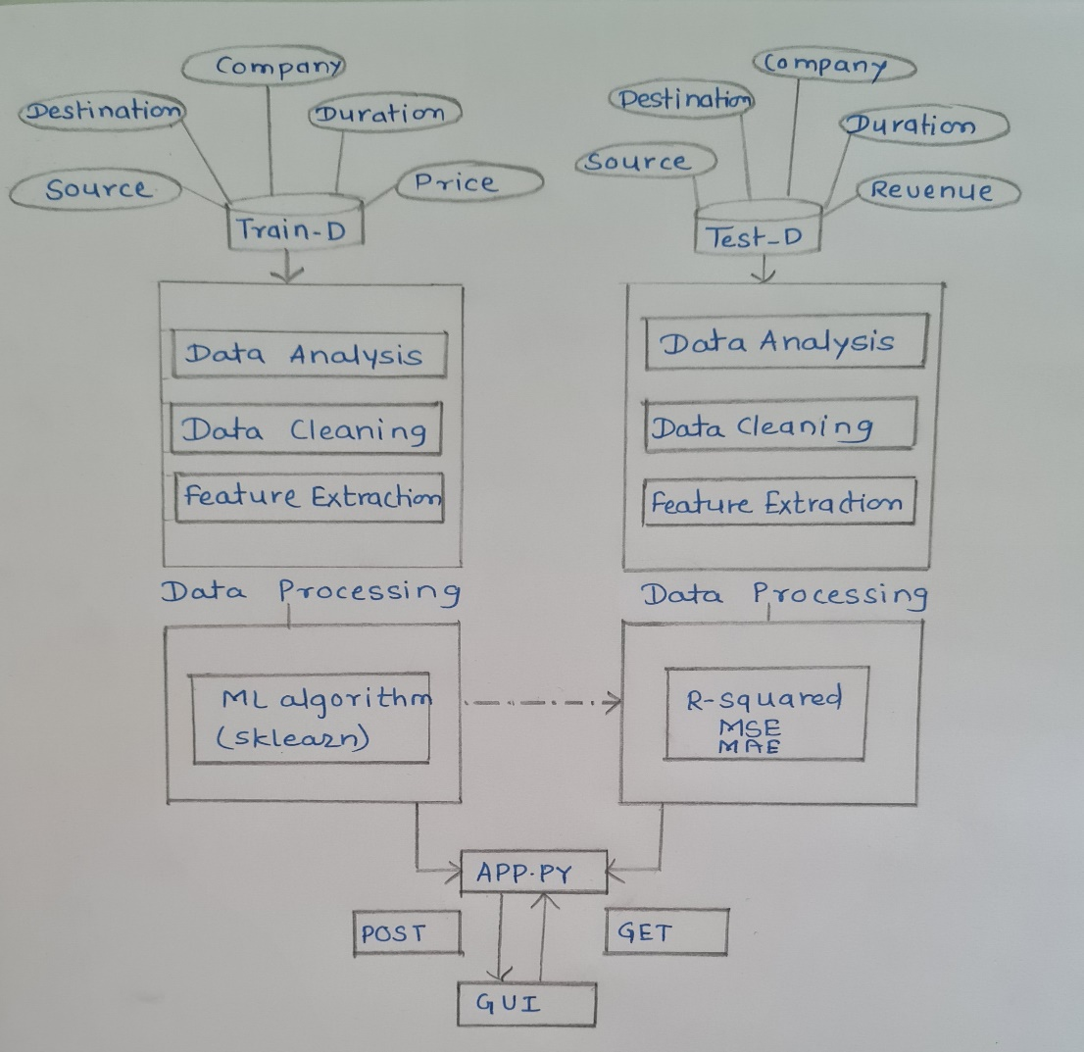
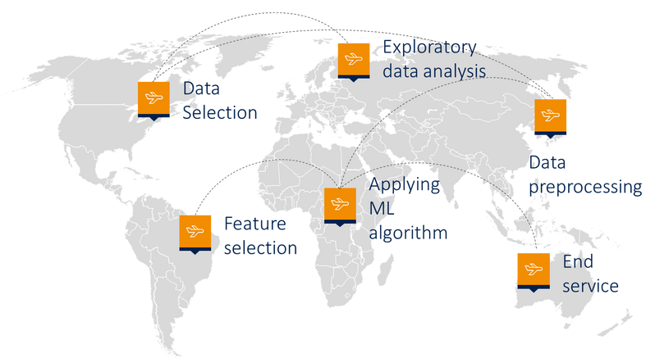
System architecture:
10

Slide 11
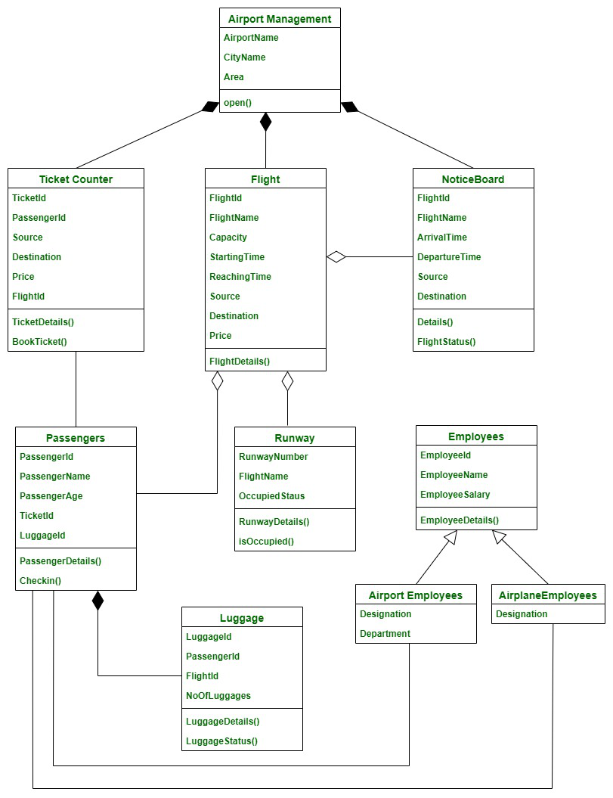
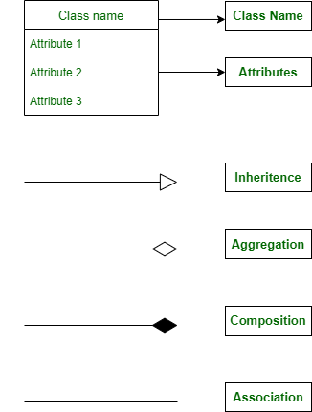
UML Diagram :
11

Slide 12
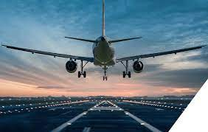
Results and Discussion
Fusion of Innovation and Trust
Revolutionizing Airline Operations
Empowering Decision-Making
Data Ethics and Transparency
Shaping Tomorrow's Aviation
12

Slide 13
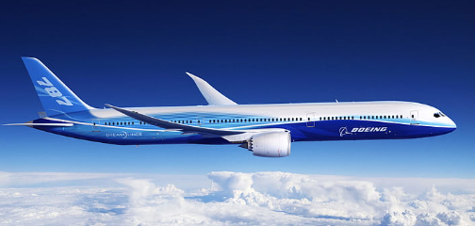
Applications:
Demand Forecasting
Predictive Maintenance
Route Optimization
Pricing
Revenue Management
13

Slide 14
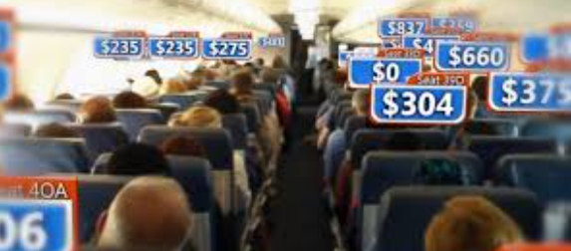
Advantages & Limitations:
Limitations:
Hardware Embedding
Network Topology
Advantages:
Cost Reduction
Economic Growth
Better Customer Experience
14

Slide 15
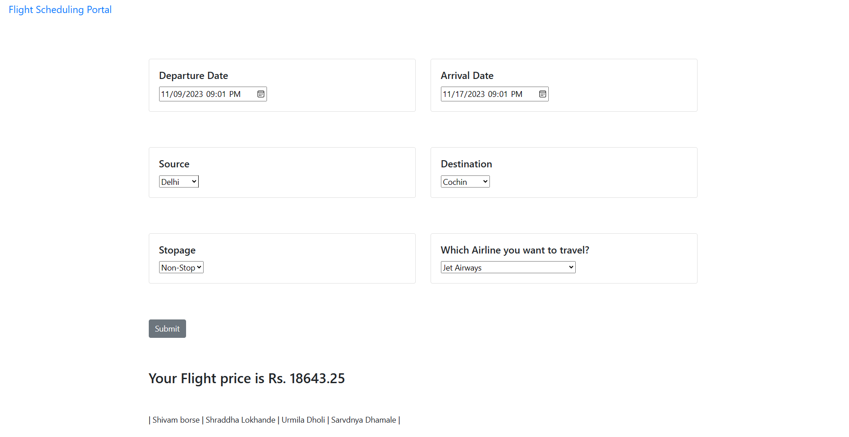
Output:
15

Slide 16
References:
[1] A Time-Optimal Trajectory Algorithm Based on Accessibility Analysis , 2021 5th International Conference on Robotics and Automation Sciences.
[2] A Framework for Airfare Price Prediction: A Machine Learning Approach , IEEE Trans. Intell.. July 2021
[3] Airline ticket price and demand prediction: A survey , IEEE Available online 5 February 2019
16

Slide 17
Thank You!
“ Aviation is proof that given the will, we have the capacity to achieve the impossible . ”
- Eddie Rickenbacker
17

Slide 18
Q&A……
18

